Slide 1
The Ongoing Manufacturing Revolution
The Internet of Things

Slide 2
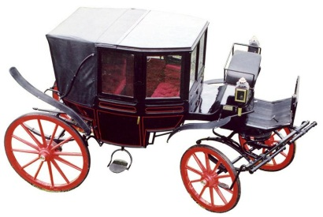
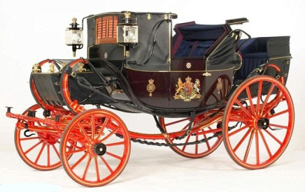
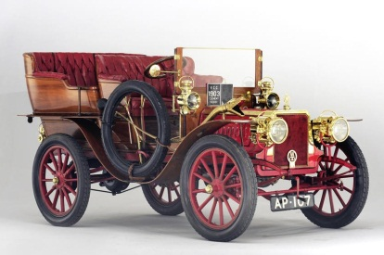
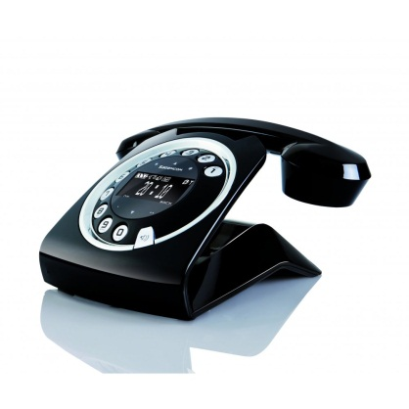
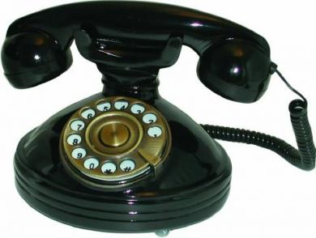
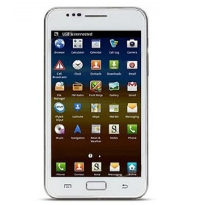
Is it Evolution or Revolution? – A Million Dollar Question
Evolution
Revolution
Early Carriage
More Fancy Carriage
Early Automobile
Evolution
Revolution
Vintage Analog Phone
Fancy Digital Phone
Smart Internet Phone
Evolution - A gradual process in which something changes progressively from one stage to another
Revolution - A total turn around; a sudden, complete, or fundamentally radical change in something
Typically, Revolution leads to further Evolution – For example, Invention of Automobile was Revolutionary however innovations such as Ground Mail and Commercial Transportation evolved Automobile invention into a Commercial Enterprise

Slide 3
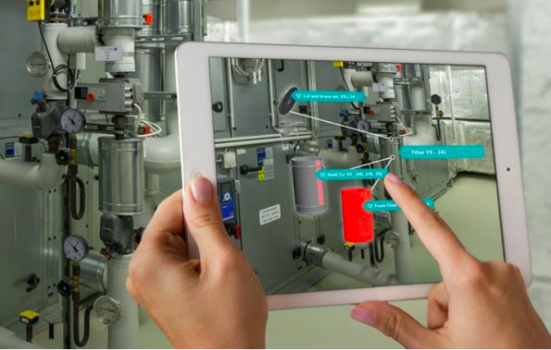
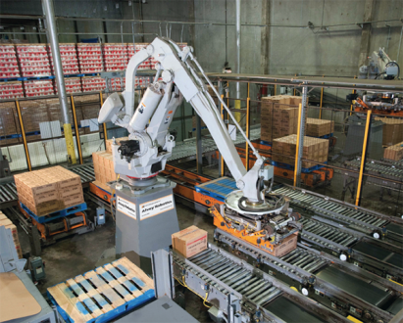
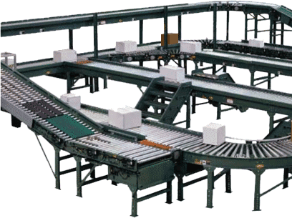
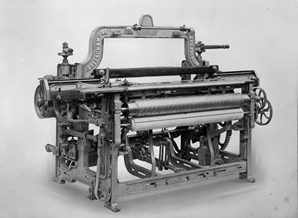
Manufacturing Revolution
– From Industry 1.0 to Industry 4.0
Industry 1.0
Industry 2.0
Industry 3.0
Industry 4.0
FIRST
Industrial Revolution
SECOND
Industrial Revolution
THIRD
Industrial Revolution
FOURTH
Industrial Revolution
Key Change:
Introduction of IoT and Cyber-Physical Systems driven by Augmented Reality & Real Time Intelligence
Key Change:
Introduction of Electronics, PLC Devices, Robots and IT to automate Production
Key Change:
Introduction of mass Manufacturing Production lines powered by Electric Energy
Key Change:
Introduction of Mechanical Production Equipment driven by Water and Stream Power
Augmented Reality Driven CPS
Level Of Complexity
PLC Driven Robots
Vintage Electric Conveyor Belt
18th Century Mechanical Loom
End of 18th Century
End of 19th Century
Q4 of 20th Century
Start of 21th Century
Notes:
Manufacturing Industry is currently experiencing a Revolution
It is commonly referred to as Industry 4.0, meaning this is 4th version of the industrial revolution
The first industrial revolution happened towards the end of 18th century when water and stream powered mechanical loom was invented
The second revolution happened towards the end of 19th century when electricity was discovered and was used in mass manufacturing production lines (Electricity driven Conveyors etc.)
The third revolution happened in Q4 of 20th century (1960s & 1970s) when Electronics, Programmable Logic Controller devices along with Robots were introduced to automate manufacturing production lines
The fourth or current revolution started in early 21st century with the introduction of Cyber Physical Systems enabled by IoT, Augmented Reality and 3D printing etc.
IoT is at the core of the 4th revolution

Slide 4
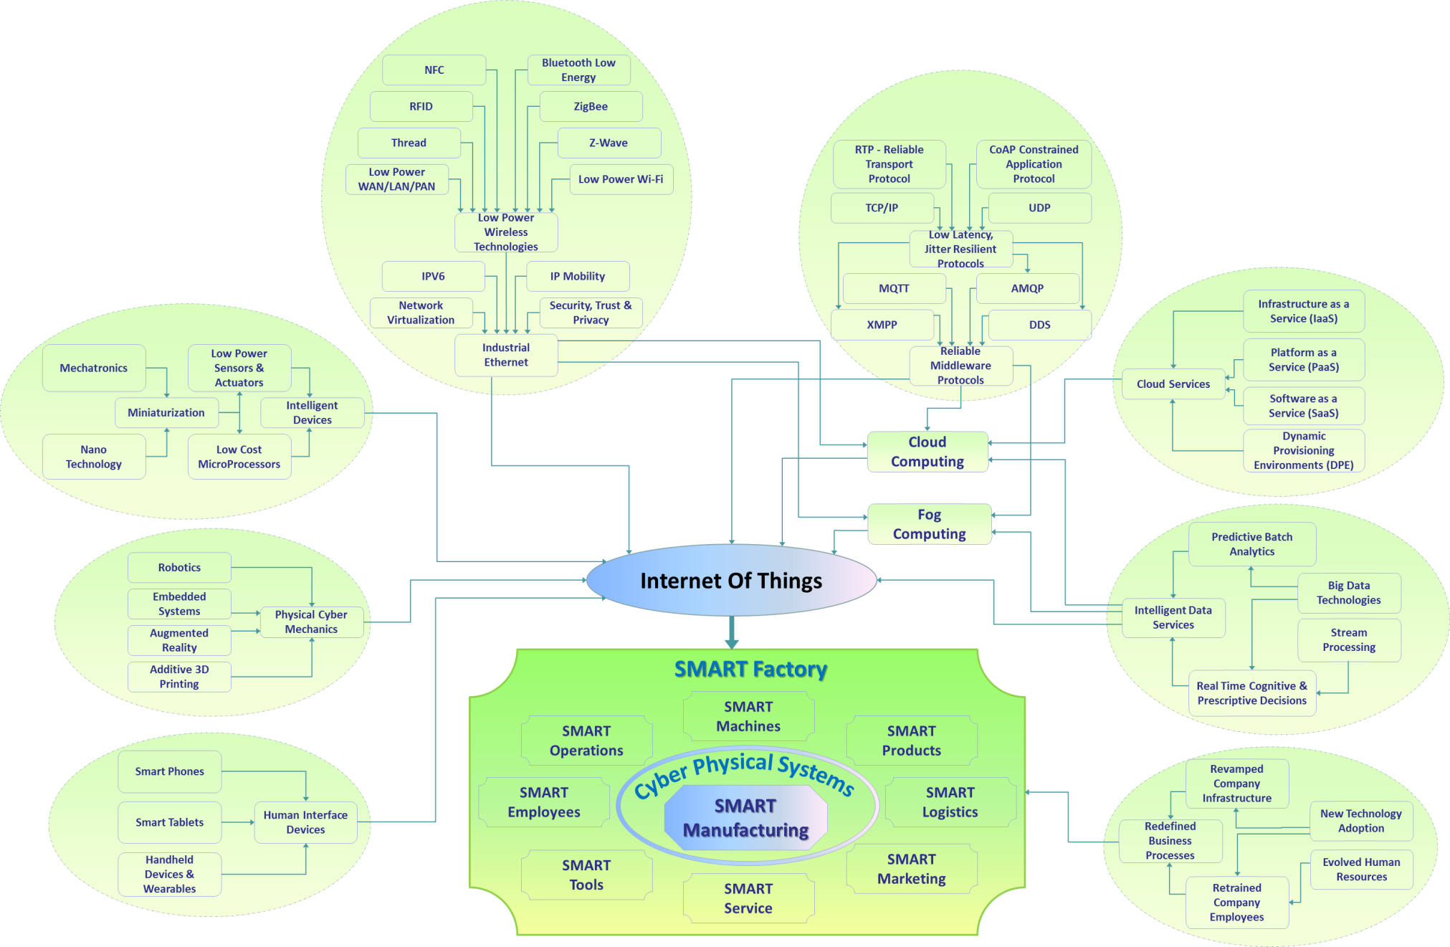
While multifaceted innovations are enabling IOT, IIOT is driving Manufacturing Revolution…..
Entrigna’s macroscopic view of the network of ‘Greenfield’ Innovations enabling IOT
Notes:
Multifaceted innovations in multiple complementary technology & business disciplines are enabling the rise of IoT
For example, there are innovations in readily usable intelligent devices such as Sensors, Actuators, ServoMotors etc. Engineering fields such as Mechatronics & Nano Technology are driving miniaturization of such intelligent devices
Likewise, advancements in Embedded systems, Robotics, Augmented reality are enabling Internet connected Smart Electro-Mechanical systems commonly referred to as Cyber-Physical Systems
While cloud computing has been around for a while, the notions of Edge & Fog computing are being evolved thereby enabling IoT in manufacturing
In turn, IoT or otherwise, IIOT in the context of manufacturing is enabling factories transform into SMART factories

Slide 5
US manufacturers are beginning to implement IoT solutions and believe IoT is required for future growth
35% are currently collecting and using data generated by smart sensors to enhance manufacturing/operating processes
70% believe it is extremely or moderately important that US manufacturers adopt an IoT strategy in their operations
38% currently embed sensors in products that enable end-users/customers to collect sensor-generated data
The North American market for IIoT will reach to $599B with a CAGR of 13.1% by 2021

Slide 6
Current IoT Landscape in Manufacturing

Slide 7
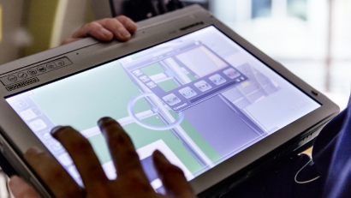
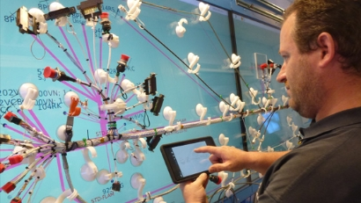

Airbus – Factory of the Future
MiRA (Mixed Reality Application) tablet
  Cross between a sensor pack and a tablet
Internet Connected Smart Tools
  Auto-adjust to different actions
  Log information
  Reduces assembly time
Augmented Reality driven instructional & educational tutorials
Photos courtesy of Airbus Factory of the Future
Notes:
Airbus revolutionized their manufacturing on many fronts.
The Challenge:
Manufacturing & assembly of Aircraft involves tens of thousands of steps and a single mistake in the process could cost hundreds of thousands of dollars to fix, makes the room for error very small
MiRA: cross between a tablet and sensor pack
Captures video from real environment
Generates a 3D model of the aircraft that can be manipulated and accessed for production work
Smart tools
smart tools understand the actions that the operator must perform next and automatically adjusts the tools to the proper settings, which simplifies the task for the operator
Once the action is completed, the smart tools can also monitor and log the results; For example, a smart tightening tool understands which task the operator is about to perform using vision to process its surroundings and automatically sets the torque. The tool would record task data in a central database. With such information, production managers can precisely pinpoint the procedures and processes for QA certification
In addition, Operators are given a smart Mobile App enabled with Augmented Reality driven instructional & educational tutorials
The sensors on smart tools can transmit alerts to the operator's smart mobile App letting operator know when the device to be operated upon is close by. The smart App would then display AR driven instructions about performing the right operations on the target device

Slide 8
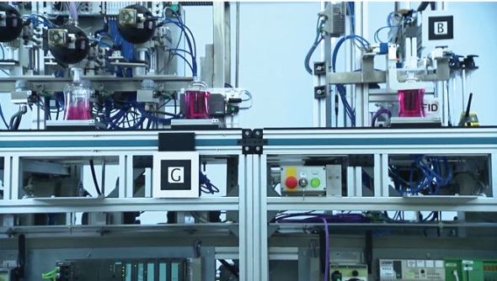
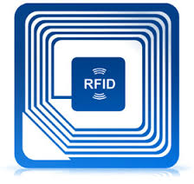
Siemens – Shampoo Plant
Bottle carriers with RFID tags can talk to machines in a production line
Smart Dispenser Machine:
  Reads RFID info
  Determines type of shampoo to fill
  Knows how much shampoo to fill
Smart Labeling Machine:
  Reads RFID info
  Determines if the bottle is filled
  Knows what label to put on the filled bottle
Eliminates the need for human input in the dispensing and labeling process
Eliminates the need for a separate
production line for each type of shampoo
Notes:
Siemens is one of the early adopters of IoT in their Manufacturing
The Challenge:
Separate production lines were needed for filling and labeling each variant of Shampoo and this was hugely inefficient in simultaneous mass production of different Shampoo types
Multi-format capable carriers were introduced that can transport different types of Shampoo containers through production line
Each carrier is equipped with an RFID tag that contains the specific Shampoo variant information
The ingredients dispenser machine would read RFID tag on the carrier and determine what quantity and which Shampoo variant to dispense
After dispensing right quantity of Shampoo variant, the dispenser machine would update the status info on the RFID tag
Next in the line is the packaging and labeling machine that would read the RFID tag on the carrier
Labeling machine first would ensure that the container has been filled by the dispenser machine by reading RFID tag status and then would determine which label to assign based on the Shampoo variant info found on the carrier’s RFID tag
Eliminates the need for human input in the dispensing and labeling process
Eliminates the need for a separate production line for each type of shampoo
Information is then collected and engineers can review to improve the process

Slide 9
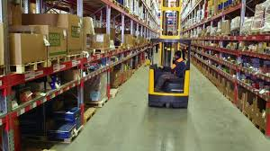
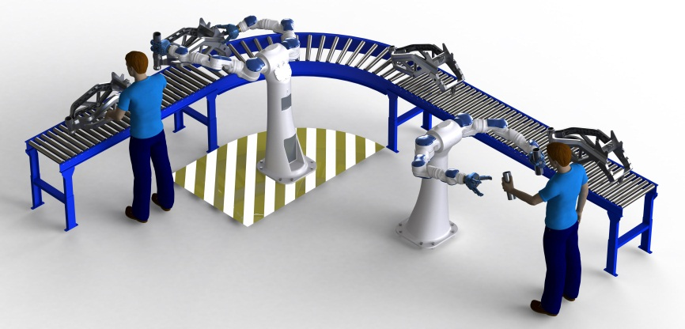
Continental AG’s SMART Factory
Active RFID tags and Geo-location are used to move the tire components throughout the factory
Collaborative robots
  Robots are “shown” how to do a task once and then they can repeat that action
  Reduces risks of injuries and reduces the need for additional assisting employees
Notes:
Continental AG is one of the first who transformed their factories into SMART factories
They introduced SMART manufacturing techniques on many fronts
The Challenge:
Physically finding input components for tire manufacturing in a massive facility was causing considerable loss of productivity. Employees knew what components are in the inventory but could not track them in the facility. If a component remained unused, it could pass its shelf life & expire
RFIDs are attached to containers that contain tire components
In-Facility Geolocation services are used to locate the specific components needed and alert forklift drivers to have them move the components quickly from current location to target location
RFID enabled components are also integrated with Inventory systems so that inventories are updated in real-time
Collaborative Robots
collaborative robots are able to work conveniently, quickly and precisely. Inherent errors are avoided and processes executed extremely dependably. This, in turn, results in quality improvements and cost savings.
This also reduces employee injuries
Deployment of collaborative Robots also reduces the need for additional assisting employees
Moreover, Many factory workers are working longer so it helps aging workers continue to do their job.
http://www.roi-international.com/fileadmin/ROI_DIALOG/ab_DIALOG_44/EN-ROI-DIALOG-49_web.pdf

Slide 10
What the Future Holds….

Slide 11
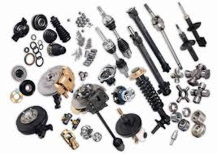
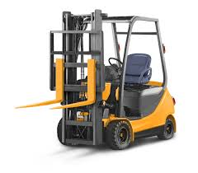
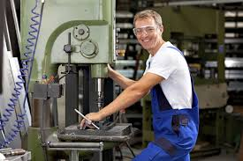
Streamlined Factories
Sensors are attached to components, forklifts, employees and other assets
Notes:
Many manufacturing companies are streamlining their factories by deploying IoT Solutions

Slide 12
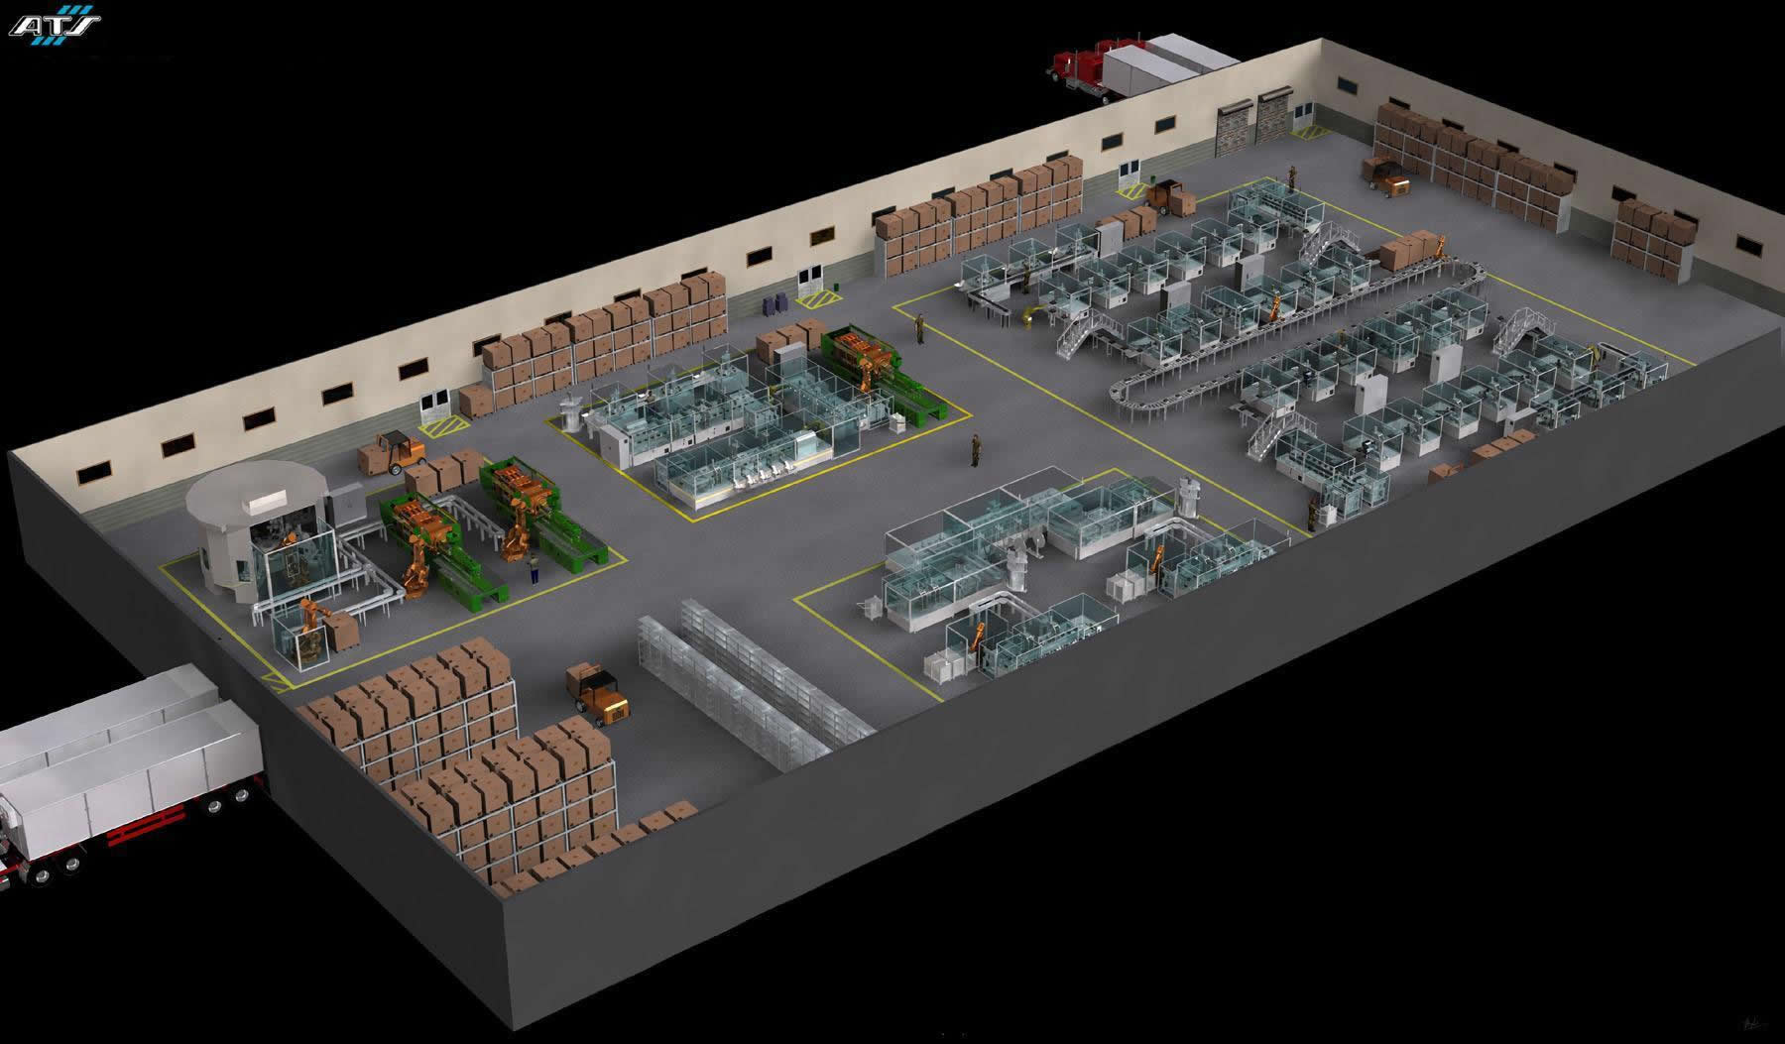
Streamlined Factories
By geolocating the sensors, one can see how people and products are moving
Processes can be streamlined and production time reduced.

Slide 13
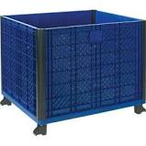
SMART Inventory management
Sensors on containers can determine when a product is running low
Employees will be alerted to proactively re-order the parts when a certain level is reached or orders can be automatically placed with suppliers
  Components will not run out or run low
  Reduced costs of production
  More uptime for factories which leads to higher productive levels
Notes:
Another critical area where IoT driven SMART solutions are being deployed is Factory inventory management
Challenge –
If not proactively monitored, components can run out or run low
Loss of productivity could be because of unavailability of required parts
On the other hand, costs can sky-rocket if surplus parts are procured quickly
Moreover, some of the parts have short shelf life and hence can expire if not used
Hence smart optimal inventory management become mandatory

Slide 14
SMART Inventory management
Sensors can also be used to determine if a container is reaching its capacity. This could trigger an alert for a forklift to remove the container and replace it with an empty one. Can also be used for waste management
  Components will not overflow from a container
  More uptime for factories which leads to higher productive levels
Notes:
Challenge –
If not proactively monitored, components can run out or run low
Increased costs can be from not producing or have to pay more to get parts quickly)

Slide 15
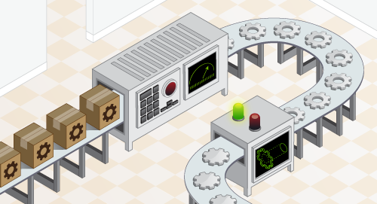
SMART Quality control
RFIDs attached to products can be used to tag defective products
If over a certain number, an employee can be alerted to see if there is a bad batch of components or if an adjustment needs to be made to the machinery
Employees can be alerted if the problem is the result of a defective part
If an adjustment is needed, it can be automatically made in real-time
  Product quality is controlled and course corrections are made while product is still moving through the production line
Notes:
Quality Control is another area where SMART solutions are being deployed

Slide 16

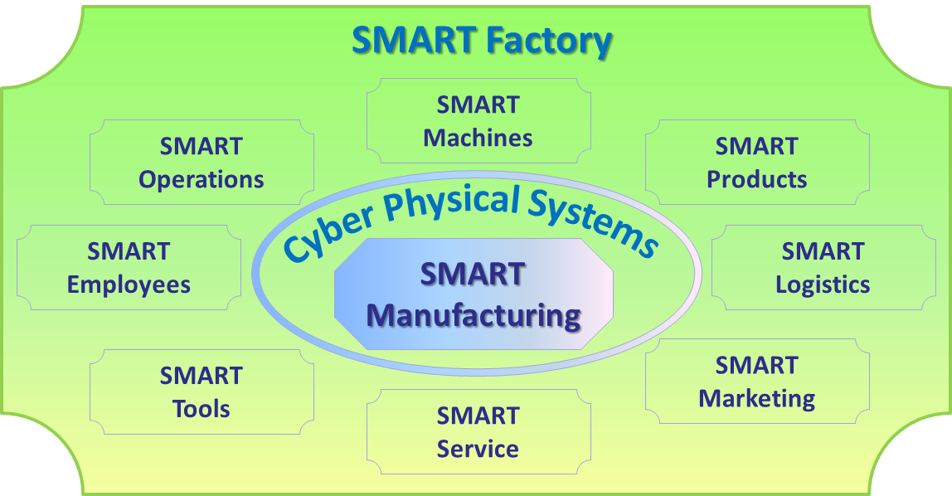
Manufacturing Revolution is shaping SMART Factories….
Smart factories are connected in a network through the use of cyber-physical production systems which lets factories and manufacturing plants react quickly to variables, such as demand levels, stock levels, machine defects, and unforeseen delays
This networking also involves the smart logistics and smart services
The whole value chain in such
integrated network is subjected to
through-engineering, where the
complete lifecycle of the product
is traced from production to
retirement through the use of IoT technologies
Notes:
- Smart manufacturing is much more than mere usage of Sensors.
- The entire value chain starting from inbound logistics through production, through outbound logistics including sales, marketing and post sales services are being electronically tracked and key assets are connected to the internet (Essentially IoT enabled)
There is both vertical and horizontal integration of smart production systems
Vertical integration refers to IoT enablement of production systems starting from inbound logistics to outbound logistics including sales & marketing
Horizontal integration refers to IoT enablement of raw material suppliers, finished products consuming business partners, post sales services to product end-users (customers) etc.
The vision of Industry 4.0 is that in the future, industrial businesses will build global networks to connect their machinery, factories, and warehousing facilities as cyber-physical systems, which will connect and control each other intelligently by sharing information that triggers actions. These cyber-physical systems will take the shape of smart factories, smart machines, smart storage facilities, and smart supply chains. This will bring about improvements in the industrial processes within manufacturing as a whole, through engineering, material usage, supply chains, and product lifecycle management.

Slide 17
Entrigna’s role in IoT Solutions

Slide 18

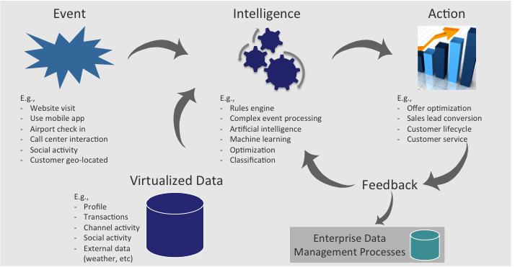
Entrigna’s RTES is analogous to a “Brain” that enables & prescribes intelligent, real-time decisions & actions
While new IOT technologies are being enabled, IIOT Reference Architectures are being conceptualized….
RTES Features
Robust set of modules including data virtualization and multiple decision frameworks
Seamless integration of product modules with flexibility to easily turn on / off
Limited, frictionless touch points with internal systems
RTES Advantages
Increased functionality and flexibility for decision services
Faster implementation timelines
Lower implementation costs
Notes:
Entrigna’s RTES is a software platform that seamlessly combines many decisioning techniques under one technology; techniques that are critically needed for IoT Fog and Cloud cognitive computing
For more information, visit entrigna.com

Slide 19
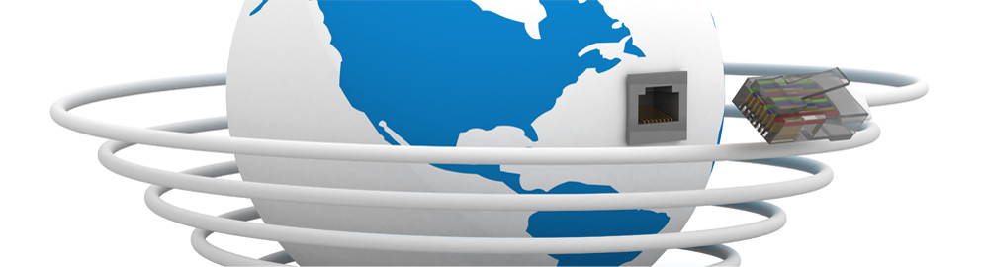
Thank You.

